Slide 1

`
An Economical Fiber Bragg Grating Interrogator for Medium-Scale Sensing Application
Based on: P. Wei, C. Cheng, L. Deng and T. Liu, “An Economical Fiber Bragg Grating Interrogator for Medium-Scale Sensing Application,” IEEE Photonics Technology Letters, vol. 28, no. 12, pp.1306-1308, 15 June, 2016.
Presenter: Ashish Kumar
Student ID: 108998404
Instructor: Prof. Peng-chun Peng

Slide 2
OUTLINE
Proposed work
Introduction
Principle
Experiment and Results
Conclusion

Slide 3
PROPOSED WORK
Authors propose and experimentally demonstrate an economical Fiber Bragg grating (FBG) interrogating scheme for medium-scale sensing application.

Slide 4
INTRODUCTION
Low cost, small size, wavelength coding and being immune to electromagnetic interference.
FBG sensor suffered from the high cost of the sensing system in competition with traditional sensing schemes.
FBG
Temperature, Pressure and Strain
Active and Passive Schemes for commercial applications.

Slide 5
Active Scheme - utilize the optical source accompanied by a tunable filter to sweep the FBGs.
Passive scheme - use a passive filter, such as wavelength division multiplexer (WDM), Mach-Zehnder interferometer and Arrayed Waveguide Grating (AWG) to measure the wavelength shift of FBGs.
These interrogating schemes are not economical enough for most medium-scale sensing applications in electric power industry.

Slide 6
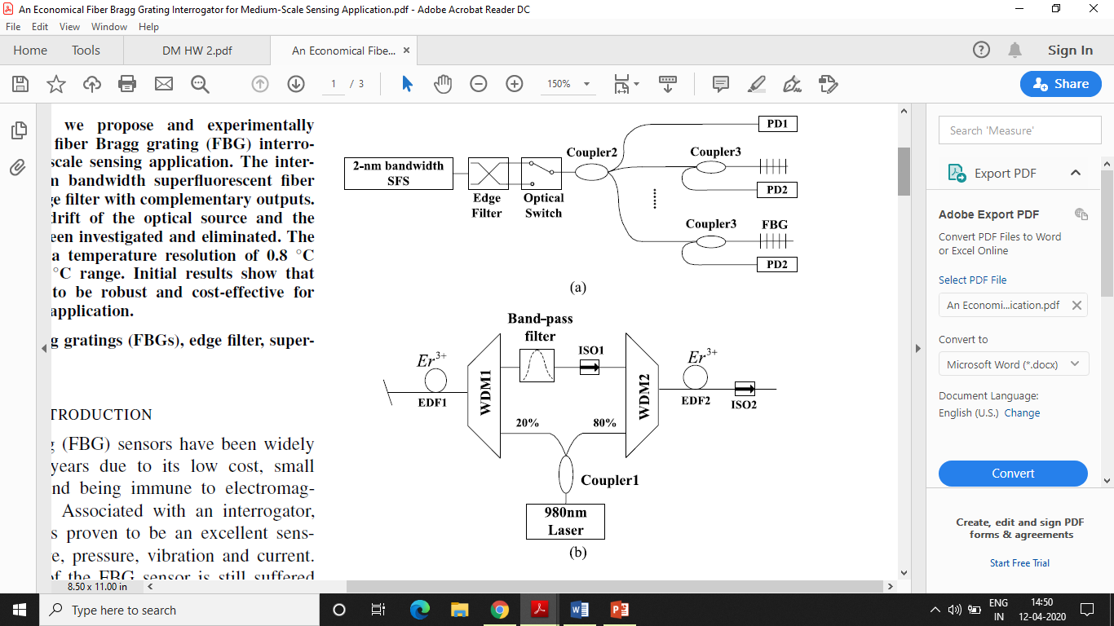
PRINCIPLE
O/P: f1 f2
1550/1570 WDM
Optical power in reference channel
SFS : Superfluorescent fiber source
ISO : Isolator
EDF : Erbium doped fiber
8 ms
Fig. 1. Basic configuration of the sensing system.
(a) system schematic
(b) 2-nm bandwidth SFS
10 m (EDF-GP980)
SFS Generated
O/P filtered
2nm bandwidth (1560-1561 and 1561-1562 nm)
Amplified
980/1550 WDMs
360mv
Lightwave

Slide 7
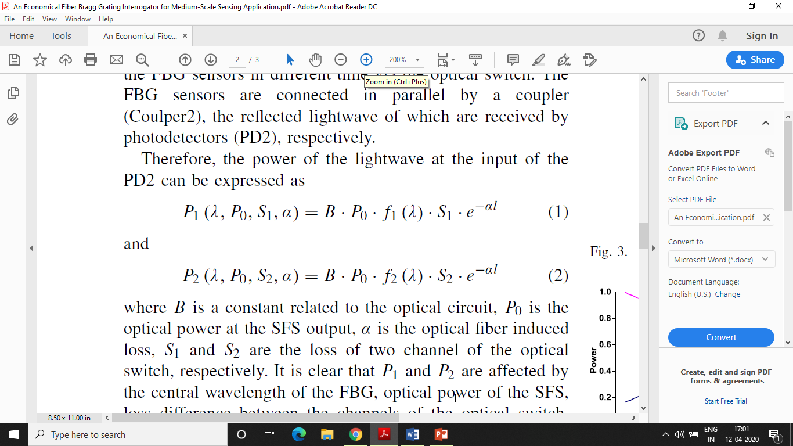
Power of the light wave at the input of the PD2 is expressed as:
B is a constant related to the optical circuit
P₀ is the optical power at the SFS output
α is the optical fiber induced loss
S1 and S2 are the loss of two channel of the optical switch

Slide 8
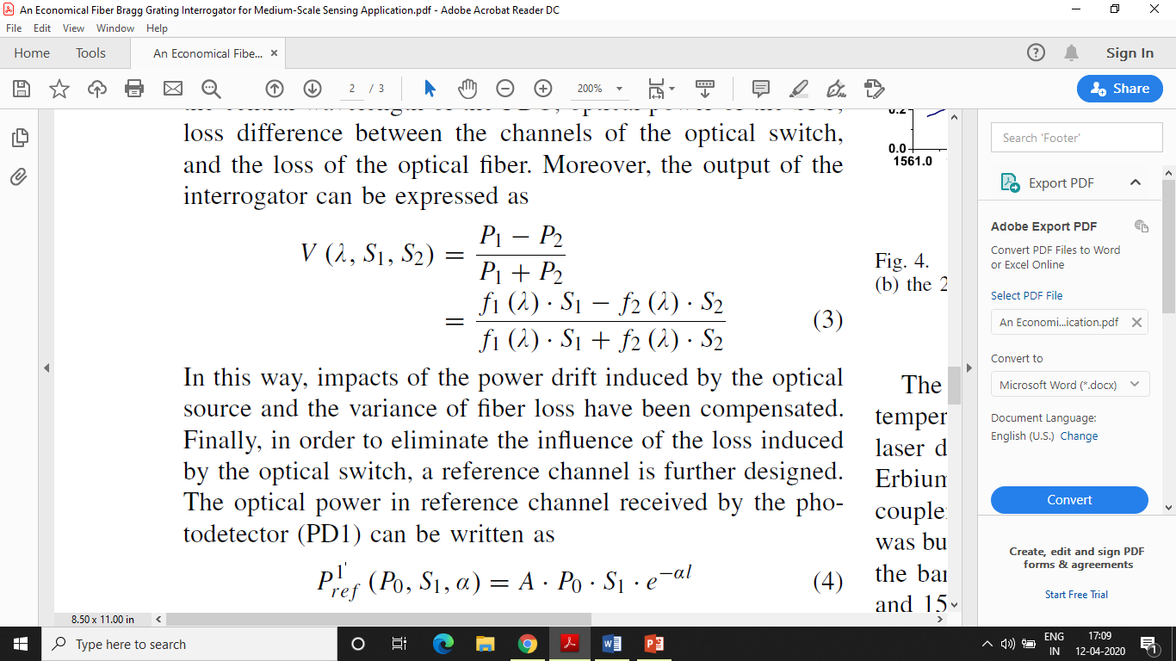
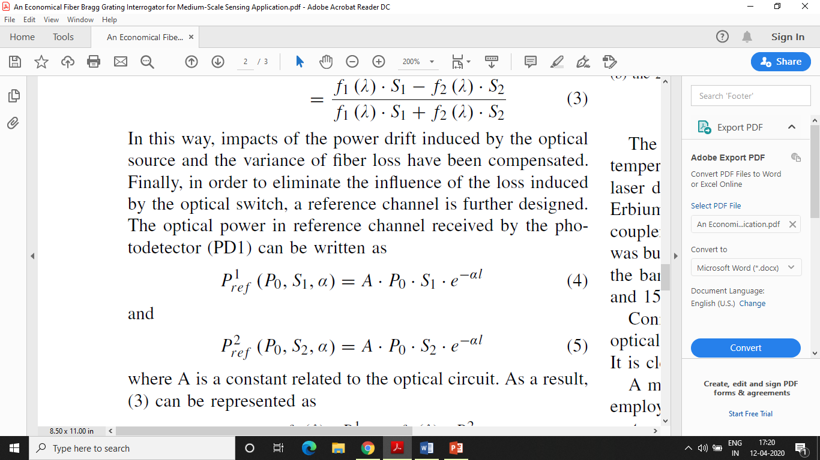
Output of interrogator is expressed as:
Optical power in reference channel received by the photodetector (PD1) can be written as:
Where, A is a constant related to the optical circuit

Slide 9
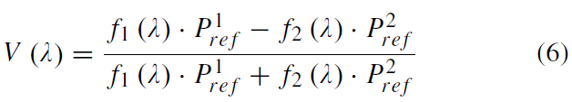
As a result, (3) can be represented as:
From (6), it is clear that the optical switch induced error has been compensated, and the output of the interrogator is related to the central wavelength of FBG only.

Slide 10
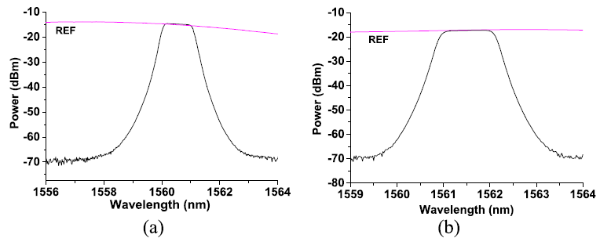
EXPERIMENT AND RESULTS
Fig. 2. The spectrum of the band-pass filter, (a) 1560-1561 nm range (b) 1561-1562 nm range.

Slide 11
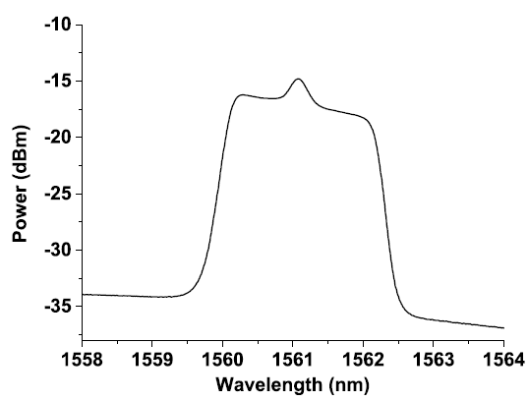
Fig. 3. Output spectrum of 2-nm bandwidth SFS.

Slide 12
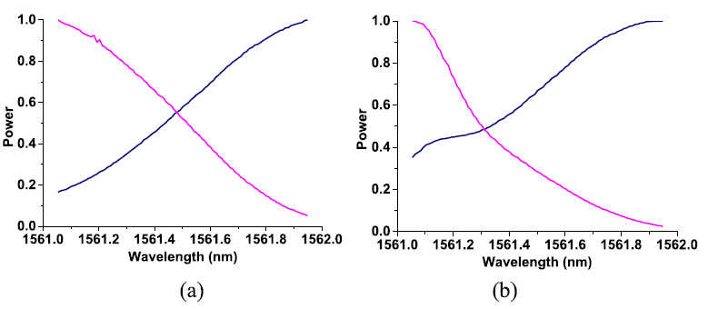
Fig. 4. Output spectrum of edge filter using, (a) SLED as the optical source (b) the 2-nm bandwidth SFS as the optical source.

Slide 13
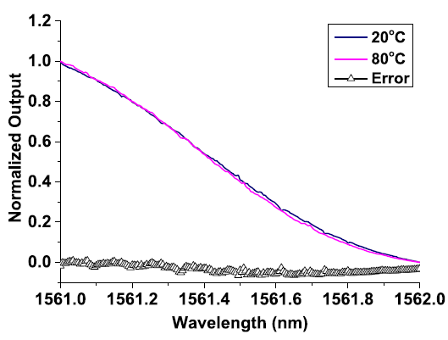
Thermal Stability Test Largest error was 0.065 at 1561.495 nm which corresponds to 20 pm. Issue of temperature can be handled by proper shielding of filter.
Fig. 5. Temperature stability of the interrogator.

Slide 14
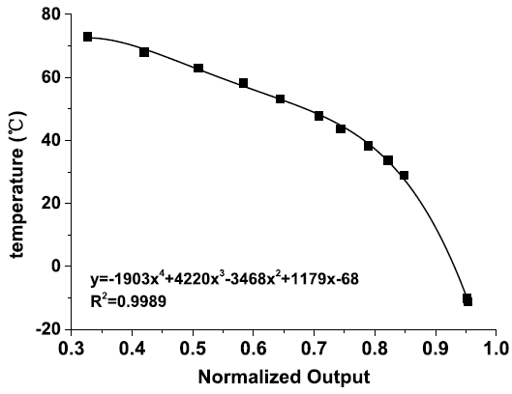
Accuracy Test
Altering temperature gain, largest error of 0.8 ºC was experimentally proved, corresponding to resolution of 8pm over the full range.
Good enough accuracy of interrogator for most of application in electric power industry.
Fig. 6. The relationship between the interrogator and the sensor.

Slide 15
CONCLUSION
Authors proposed and experimentally demonstrated an economical FBG interrogating scheme for medium scale sensing applications.
The robustness of the interrogator against the variances of the SFS output, fiber loss and surrounding temperature was carefully considered and the temperature resolution of 0.8 °C was experimentally proved over 90 °C range.
The interrogator is designed using simple and economical optical devices and is proved to be cost effective for medium-scale sensing application

Slide 16
Thank You!!

